Slide 1

Memory Skills Group
Week 3 : External memory enhancement strategies
Rebecca Niebieszczanski (Trainee Clinical Psychologist)
Kirsty Ellis (Assistant Psychologist)
Lesley Stewart (Consultant Clinical Neuropsychologist)
Revised 2021
Grace Sunerton (Assistant Psychologist)
Alice Roblin (Senior Clinical Psychologist)

Slide 2

Welcome!
Notes:
Welcome participants to the group
Explain that the group is for individuals who report difficulties with their memory
Important that we have realistic expectations that the group is not about ‘getting rid’ of our memory difficulties
The group will offer skills and information that will help us to manage these memory difficulties
2 hours with break

Slide 3




Housekeeping:
Notes:
Breaks – including toilet breaks
No recording of the session
Mobile phones on silent/vibrate to minimise distractions

Slide 4
Session outline
Mindfulness exercise
Recap on the previous session
Review of out of session work
Communicating cognitive difficulties to others
Overview of memory strategies
Out-of-session work.
Summary

Slide 5
Mindfulness exercise

Slide 6

Setting weekly goals
Were you able to do it?
Was it difficult to do?
Was it helpful/unhelpful?

Slide 7

Communicating my difficulties to others
Pros and cons
Who might it be important to tell?
How might we go about telling others about my cognitive difficulties?
Notes:
In pairs

Slide 8

External strategies – What are they?
Changes to the environment that we can make to compensate for our memory problems
They are generally either…
Visual aids
Verbal Aids

Slide 9
Why use external strategies
Its not about ‘getting rid’ of memory problems
Its making the best use of things in the environment to help compensate for your memory
It takes pressure off you having to remember lots of things
Fairly simple to do, but important to make them part of your routine
Most of us use these kinds of strategies everyday.

Slide 10
Organisation – notes
Journal – writing down the events of the day and looking back on them at a later stage
Post-it notes – little reminders e.g. a note next to your door to remind you lock in when you come in at night
To do lists – a daily list of things to do which you can ‘tick off’ if you have completed something.

Slide 11
Organisation – sorting
Everything has its place!
Finding things – e.g. keys in a bowl, glasses on the night stand, wallet in your left jacket pocket
Sort items into drawers, cupboards and shelves
Folders/files for important documents
Label drawers, doors, cabinets, files and boxes.

Slide 12
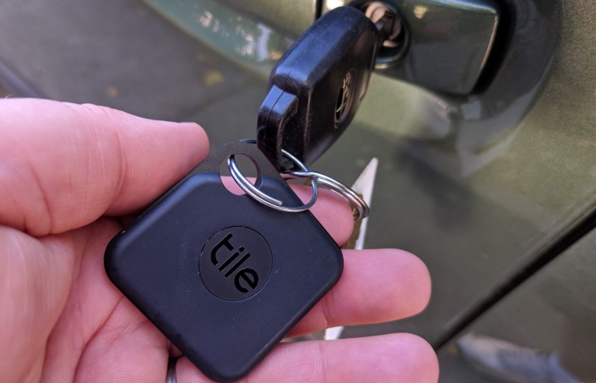
Technology
Organisation:
Apple/android calendars for appointments (setting alarms and reminders).
Apps e.g. ‘Trello’, Evernote, memento, Todoist
Google maps if you can’t remember the route to your destination (save locations).
Tile bluetooth stickers
Find my friends on iPhone and share location on Whatsapp.

Slide 13
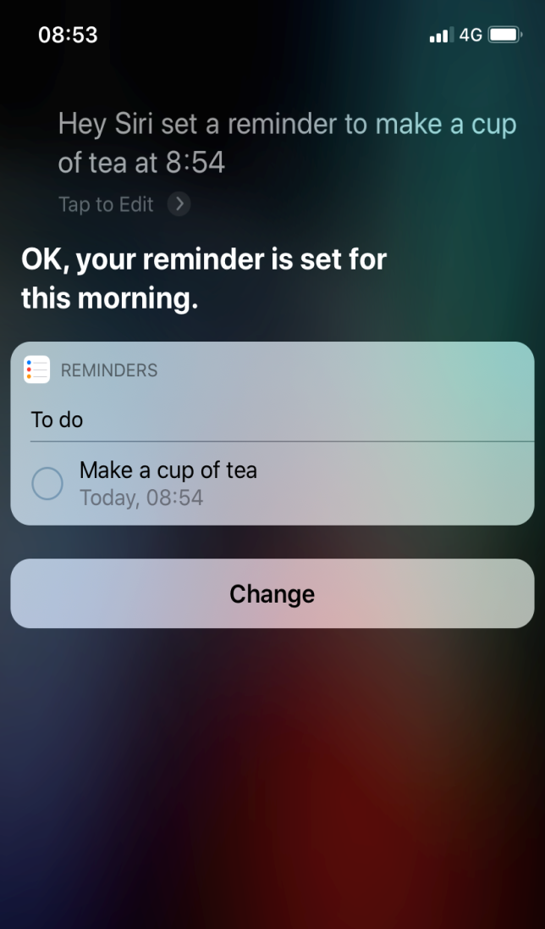

Using voice control on your phone/speaker

Slide 14


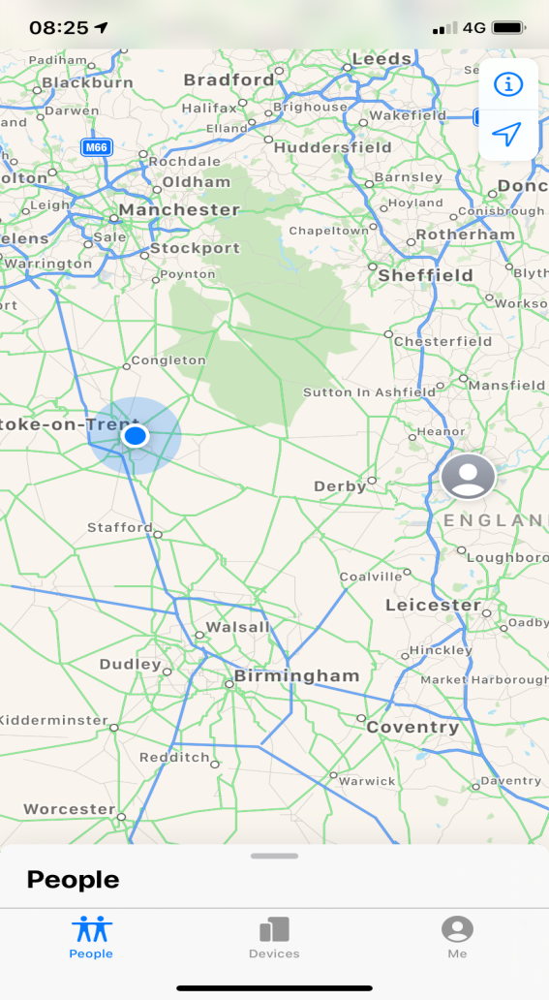
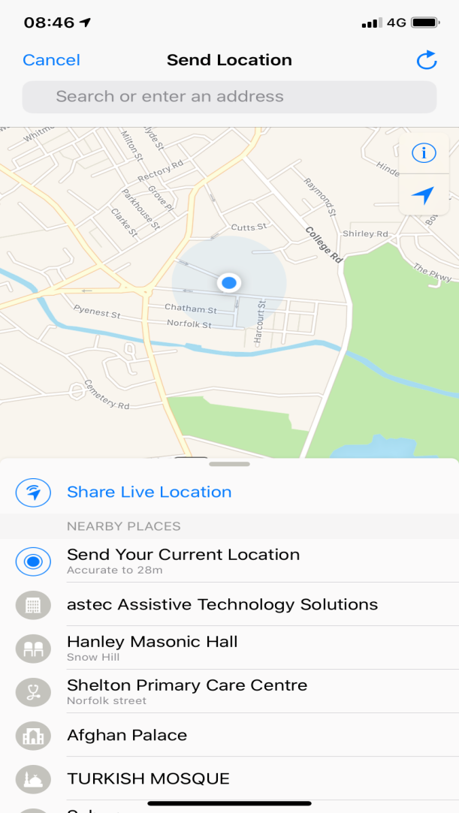
Find My Friends (IPhone)
WhatsApp

Slide 16
Remembering names: Quick Exercise
Notes:
Not a test!

Slide 17
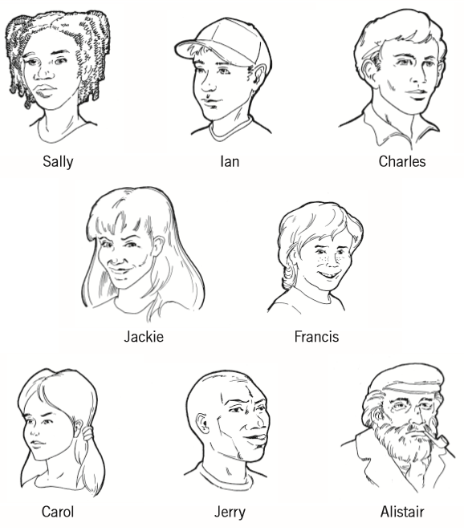

Slide 18
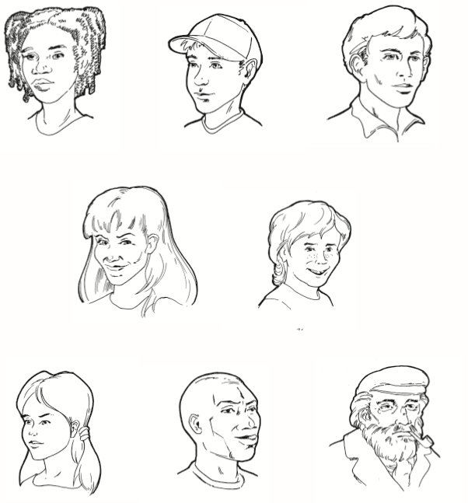

Slide 19
How many did you remember? Did you use any strategies?

Slide 20

Internal Strategies – what are they?
Internal memory enhancement strategies are strategies that we use within our minds to aid memory.
Notes:
Things you ‘do inside your head’ to try to remember things. For example, thinking in a particular way or trying to visualise something as a picture.

Slide 21
Internal Strategies – why use them?
Can help us to pay attention and process information by relying on our inner/internal resources.
They focus on different parts of the process of memory, including encoding, storage and retrieval and can be useful for remembering new information.
More effort to use than external strategies and require practice!
Might be best used for remembering specific things e.g. names
There might be situations when external strategies aren’t available e.g. names

Slide 22

Mindfulness
The aim of this is just to help us be more present ‘in the moment’, and give us some time to become more aware of our thoughts, feelings and any physical sensations.
Attention
Retrieval

Slide 23
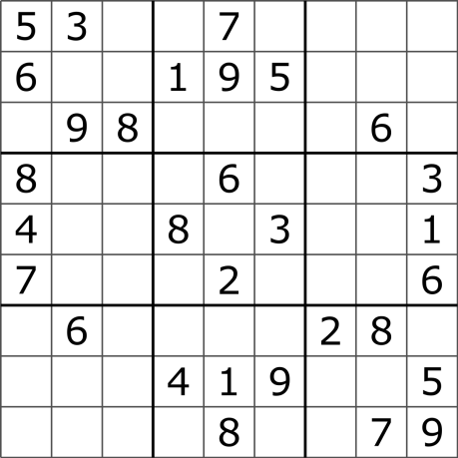
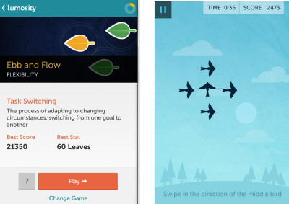
Brain Exercise
Training and keeping the pathways in the brain active.
Doesn’t necessarily improve difficulties but helps to keep our brains active.
Sudoku, puzzles, arithmetic, apps, having a conversation!

Slide 24
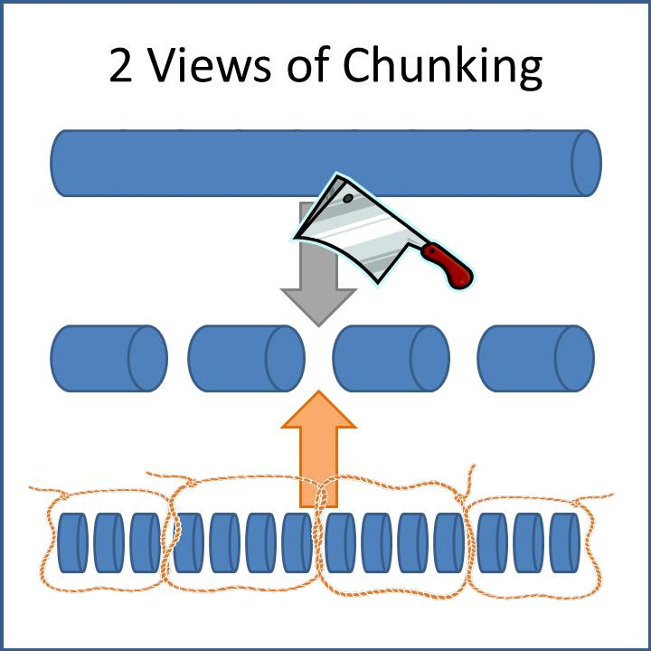
Chunking of Information
Chunk information together
Phone numbers
Group information
Shopping list in categories
Encoding

Slide 25
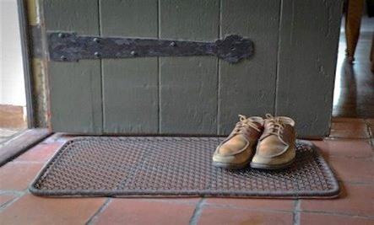
Making associations
Associations between something you need to remember and previous knowledge can help us to make the new information more meaningful and we therefore remember it better
Link new activities to existing ones
Names with something or someone you know
Items linked with activity visible
Notes:
Remembering to do a new activity by linking it to an existing one. For example, taking medication at meal times
Learning a new name by associating it with something or someone you already know. For example, you might remember the name Angela by thinking of an angel.
Leaving an item associated with an activity visible so you remember to do it. E.g. leaving the boots by the door so you remember to take the dog for a walk.

Slide 26
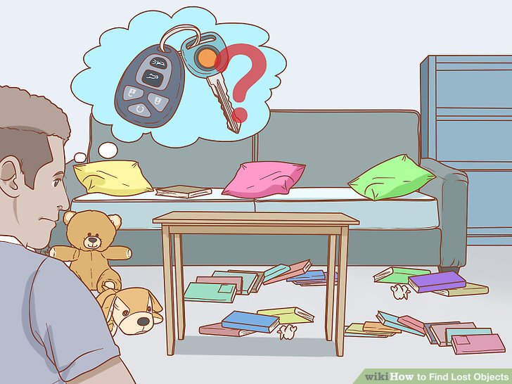
Visual Imagery
Using visual imagery can be helpful for learning and remembering information
Things to do
Routes
Retracing
Notes:
Things to do - If you need to complete a task like posting a letter, you can imagine yourself doing that task. By making the association between the post-box and the action of posting the letter you’re more likely to remember to do it.
Routes – If you need to remember a new route it can be useful imagining yourself walking the route.
Retracing

Slide 27
Remembering names using association/imagery: lets have a go!
Notes:
Not a test, just to show how it might be used to help remember a name using a strategy.

Slide 28
Notes:
Say the name to yourself, make sure you have a clear mental image of that name
Does the name suggest an association to you? Make as many associations as possible
Try to link the name to the face, the more bizarre the better!

Slide 30

Stories
Making up stories can be useful for remembering things
Shopping list
Sequence
Notes:
For example, if you had a shopping list of weetabix, milk, jam, teabags and toothpaste you might create a story like ‘In the morning I get up and have my Weetabix with milk and jam then I have a nice cup of tea before I brush my teeth’.

Slide 31

Errorless Learning
You can learn more efficiently if you get it right the first time
Don’t guess! It is likely you will remember the wrong answer rather than the right answer!
Cues
Prompts
Scaffolding
Notes:
Normally we can learn from mistakes, however if the process of learning is compromised, it may be better to use this strategy.

Slide 32
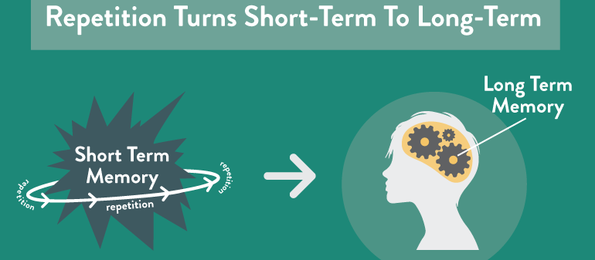
Repetition
When trying to encode information into you memory, rehearse it.
Names
Phone numbers

Slide 33
Expanded Rehearsal
A learning technique, it means that you review information at gradually increasing intervals.
If you are unable to recall the score correctly, review the information and shorten the interval to when you could remember the information
first review: immediately
second review: 24 hours later
third review: one week later
fourth review: one month later
fifth review: three months later

Slide 34

Question – 5Ws + PQRST
The PQRST method is used to help improve our memory for information that we read
Preview
Question
Read
Summary
Test
5Ws
Who
What
Where
When
Why
Notes:
Break information down into separate categories. Use these questions like ‘coat hook’s to hang information on. Help to make the information more meaningful and give you context.

Slide 35
Stage | Strategies
Attention | Mindfulness meditation Making associations Visual imagery
Information processing | Making associations Visual imagery
Encoding and storage | Chunking Grouping PQRST Repetition Expanding rehearsal Making associations Stories Visual imagery
Retrieval | Mindfulness meditation Mental retracing Making associations Visual imagery

Slide 36
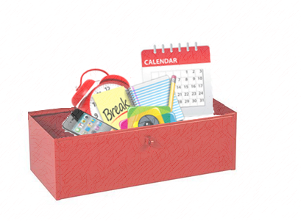
Creating a memory ‘tool box’
Making a plan about which strategies may be useful for you
Focusing on one strategy at a time
For strategies to ‘stick’ they need to become part of your routine.

Slide 37
What might get in the way of using these strategies successfully?

Slide 38
Tips to get you started
Start simple
Keep it slow
Keep a routine
Choose the right time off the day to try these strategies.

Slide 39
How do I know which strategies will be most useful for me?
Do I have a specific difficulty with my memory?
Do I remember information better when I see or hear things?
Do I forget things shortly after they’ve happened or after an extended period of time?
Are you having a specific difficulty during the process of learning?
Notes:
Link to ‘difficulties’ from discussion session 2

Slide 40
Out of Session Work
Weekly
SMART goals
Review in following session
Notes:
Helpful to think about own difficulties and to identify any strategies that are already providing to be useful, share them with the group

Slide 41

Summary
Mindfulness exercise
Recap on the previous session
Communicating cognitive difficulties to others
Overview of memory strategies
Out-of-session work.

Slide 42
Thank you for attending
Grace Sunerton, Assistant Psychologist
Jessica Haselhurt, Trainee Clinical Psychologist
01782 275188
Notes:
Contact details if you are having difficulties with the programme. There will also be space to ask any questions and explore with us your difficulties within the group if you feel comfortable sharing these.

